Slide 1



SHOP HOP
IGATE is now a part of Capgemini

Slide 2
TEAM MEMBERS
Bilwa Pelapkar
Bineet Jaiswal
Chinmayee Khadapkar
Kavita Maurya
Rajib Ghosh

Slide 3
OVERVIEW OF THE PROJECT
This project is about an e-commerce website.
Website allows user to view products and allows them to purchase it if interested.
It’s a shopping site which is designed for shopping of women clothing.
They can save their time and shop from where ever and when ever they need.
The Application link is: http://www.automationpractice.com

Slide 4
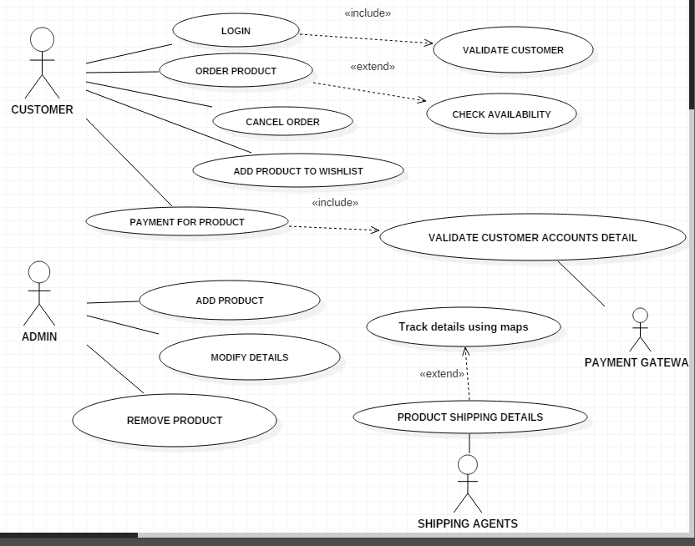
USE CASE

Slide 5
TEST CASES
This is the link for test cases :

Slide 6

DFDR

Slide 7
Defects Found…

Slide 8
Test Case Adequacy :

Slide 9
Test Case Effectiveness:

Slide 10
Traceability Matrix

Slide 11
Thank You

